Slide 1




ICAISA-2023
GCD Thresholding Function applied on an image with Global Thresholding
Presented By – Mr. Hussain Kaide Johar Manasi
Maulana Azad National Institute of Technology, Bhopal
Co-author: Dr. Jyoti Bharti (Faculty in MANIT Bhopal)
International Conference on Advances in IoT, Security with AI (ICAISA-2023)
24 – 25 March, 2023
Organized By
Deen Dayal Upadhyaya College, University of Delhi, New Delhi, India
University of Canberra, Australia
NIT Arunachal Pradesh, India
Our Sponsors

Slide 2
Thresholding & Segmentation
ICAISA-2023
To distinguish between foreground and background of an image.
Otsu most reliable generally, but demands high computation.
Some types of thresholding and segmentation techniques
Global
Adaptive Thresholding
Region Based
Edge Detection

Slide 3
Using GCD for thresholding
ICAISA-2023
The GCD or Greatest Common Divisor of 2 numbers should provide a 3rd value that effectively accommodates the similarities in the 2 values.
For 2 very similar numbers it can help group in one part of the threshold, but for 2 values with a higher range, the GCD has the potential to create an appropriate partitioning metric.

Slide 4
Implementation Challenges
ICAISA-2023
Runtime of the algorithm
Robustness against block size
Failure of the algorithm with extremely dark or bright images
Distinguishing factor

Slide 5


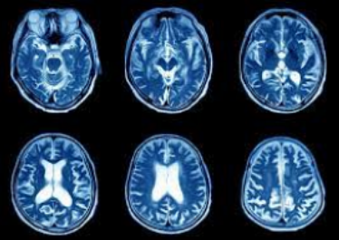
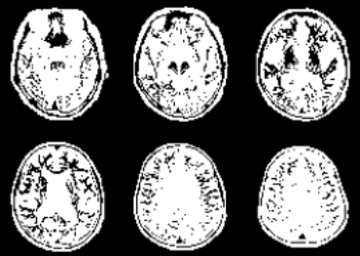


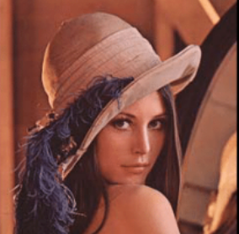
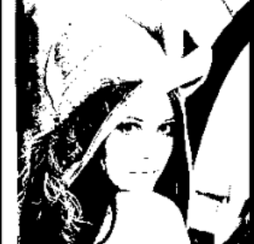
Results of Algorithm I
ICAISA-2023
Regular, T = 183
Medical Scans, T = 58
Darker Images, T = 26
Standard, T = 72

Slide 6
Algorithm II
ICAISA-2023
Steps
First take all pixel values in that block and reshape them into a 1-D array of just normal values.
Take the GCD of all the pairs of values in the formed 1-D array.
Take the summation of the elements in the blocks and store them in another array that stores the sums of the different blocks.
Find the mean(%255) of all the elements in the list of sums of the blocks. That is the threshold value that will be applied.
Features
Higher Thresholds
High Execution Time
Increasing Block Size Fails

Slide 7

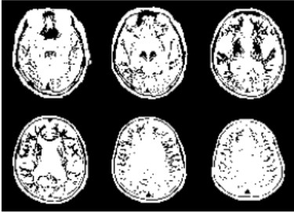

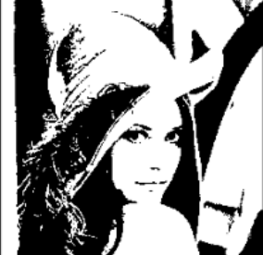
Results of Algorithm II
ICAISA-2023
Regular, T = 219
Medical Scans, T = 58
Darker Images, T = 37
Standard, T = 84

Slide 8
Algorithm III
ICAISA-2023
Initialise a dictionary of 256 keys and initialize their values to 0
Loop over each pixel for each block and increment value of corresponding keys in the dictionary
Then iterates over the dictionary to calculate the GCDs of all the key pairswith non-zero values. For pixel values that repeat more than once, their GCDs amongst the other pixels are simply calculated by factoring in their dictionary values.
Do this for each block while accommodating the leftover pixels that wouldn’t fit perfectly into a block
Finally find the mean of the obtained resulting list of sums of all blocks.

Slide 9
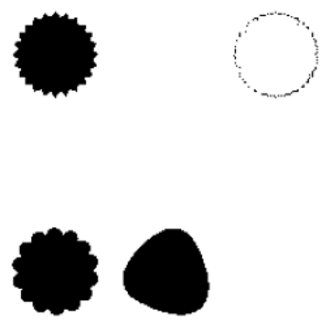
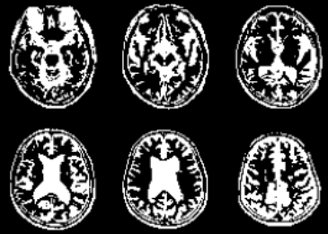
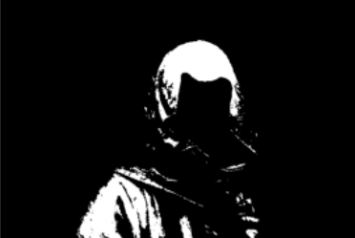
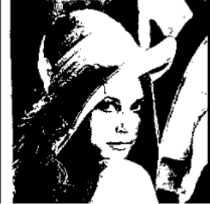
Results of Algorithm III
ICAISA-2023
Regular, T = 88
Medical Scans, T = 105
Darker Images, T = 53
Standard, T = 100

Slide 10
Conclusion
ICAISA-2023
Algorithm III provides a reliable way to use GCD for segmentation
Further Work includes applying this algorithm to multiple domains, while varying block sizes and image selection
Effective usage of appropriate data structures could further speed up the algorithm.

